Slide 1
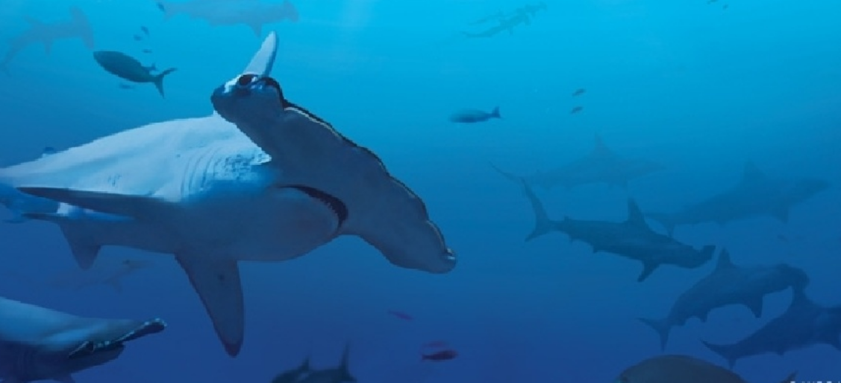
Stop Shark Finning
(removal and retention of shark fins mainly for SOUP)

Slide 2
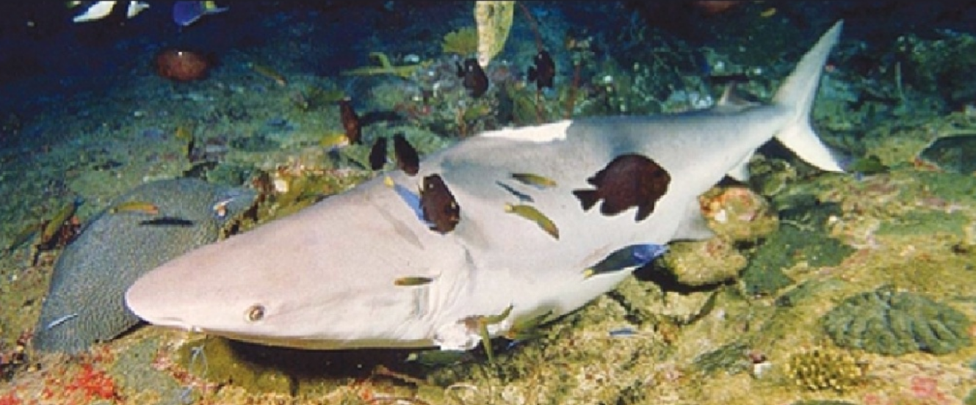
Sharks are often killed for “shark fin soup”: the finning process involves capture of a live shark, the removal of the fin with a hot metal blade, and then release of the live animal back into the water (where it will eventually die).

Slide 3
Sharkfinning: Sharks greates threat
Cruel practise of slicing off fins – then dumping the fish
Often still alive; unable to move normally, they die of suffocation or are eaten by other predators.
increase profitability and increase the number of sharks harvested
95% of fish is wasted – fin is most valuable
largely unregulated shark fin trade
Estimates of the global value of the shark fin trade range from a minimum of US$540 Million to US$1.2 billion.

Slide 4
Sharkfinning: Sharks greates threat
Millions of tons of shark fin harvested per year – and growing
Used as a tasteless ingredient in a social status soup
Demand continues to increase while supply plummets
Worldwide problem
All ages, sex and species killed

Slide 5
Shark fin soup
Sign of prosperity and respect especially in Asia (and particularly in China)
Soup costs as much as $70 to $150 per bowl
Only foods like caviar and truffles are more expensive
Dried shark fins cost anywhere between $100 to $300 per pound
A single Whale shark fin can sell for up to $20.000
The “shark fin market” alone causes between
26 and 73 million shark death each year
(Global shark catch in 2012 was 100 million)

Slide 6
Shark fin soup
MYTH | FACT
Sign of prosperity | Only for trading firms
Tastes great | Has no taste
Cures arthritis, cancer, HIV | Contains highly poisonous mercury (infertility!)
Sharks don’t get sick | Sharks get cancer and tumors

Slide 7
… per country legislation
Country/Area | Legislation
EU | land only sharks that retained all their fins (Nov. 2012)
Australia | Finning is not. Fins must be landed attached, and additional regulations apply in some states or territories.
Canada | Shark finning has been illegal in Canada since 1994, but importing fins from other regions without such regulations is allowed (Cities “try” banning fins)
China | None
Hongkong | None
Taiwan | Banned shark finning in 2011
Malysia | None
New Zealand | Only the Great White is protected

Slide 8
… per country legislation
Country/Area | Legislation
Palau | world's first shark sanctuary – no shark catching in an area the size of France
Singapore | None (supermarkets stop selling)
USA | Shark Finning Prohibition Act of 2000 – but only for US vessels (and other loopholes) Shark Conservation Act 2011 2010 Hawaii first state to ban fins in general – other states followed with NY pending (important!)
But as with any laws there are many ways around...

Slide 9
Sharks are endangered
90 % of some shark species have been destroyed
Demand for shark is at an all-time high
Even marine reserves are targets
No international laws
23% of all shark species (there are > 500!) are officially “endangered” (World Conservation Union)
42% of Mediterranean shark species are endagered

Slide 10
Why should we care
Sharks have been here for more then 450 Million Years (compared to 4.5 Million for humans)
Oceans are the most important ecosystem in the world – and sharks are an integral part of it
Missing these predators puts the system into an imbalance

Slide 11
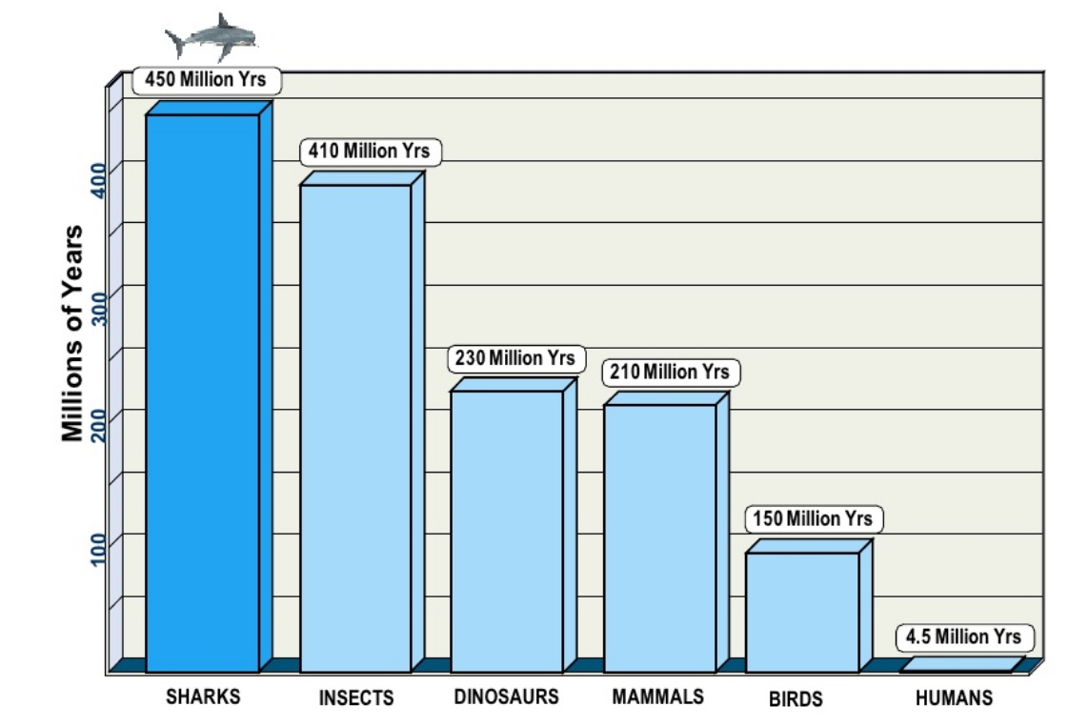

Slide 12
Why can we do?
Don’t fear the sharks (Our irrational fear of sharks explains our lack of desire to conserve them)
Walk out of restaurants which offer sharkfin soup (like Steve Irwin)
Learn more about sharks
Dive with sharks to increase tourism
Reduce fishing pressure by eating sensible
Educate friends, family and anyone else

